Slide 1
Stroke Prediction Using Machine Learning
Name: Garvit Joshi
Section: K21UN
Registration Number: 12106692
Supervisor: Mr. Ved Prakash Chaubey

Slide 2
Abstract
Stroke, a cerebrovascular accident (CVA), results from interrupted brain blood flow, causing dysfunction.
Ischemic or hemorrhagic strokes, from inadequate blood supply or bleeding, demand immediate medical attention.
Timely intervention for ischemic strokes within hours of symptom onset is crucial for effective management.
Transient ischemic attacks (TIAs) require urgent evaluation to mitigate future stroke risks; symptoms should resolve within 24 hours.

Slide 3
Problem
Brain stroke, a leading cause of mortality and disability globally, requires early detection and intervention for improved outcomes.
Advancements in machine learning enable predictive models for stroke risk assessment based on demographic, clinical, and lifestyle data.
This project aims to develop a machine learning-based predictive model for stroke prediction, utilizing patient data for risk identification.
Early identification of high-risk individuals allows for timely interventions, enhancing stroke prevention strategies and patient care quality.

Slide 4
Problem Statement solution Approach
Develop predictive models for stroke risk assessment using machine learning, coupled with launching public health campaigns for stroke prevention awareness.
Utilize machine learning algorithms to optimize resource allocation and deliver cost-effective stroke care and rehabilitation programs.
Enhance post-stroke rehabilitation by employing personalized plans aided by machine learning and improving access to psychological support services and community programs.
Foster interdisciplinary collaboration among healthcare professionals, researchers, and policymakers to innovate stroke prevention, care, and rehabilitation strategies while investing in research to advance stroke treatment and patient outcomes.

Slide 5
Methodology
1. Data Collection:
Collected data from Kaggle with highest Usability Factor for an authentic dataset.
2. Data Preprocessing:
Finding null values, and correlations between the columns knowing how change of one affect other.
3. Model Training:
Encode the values such as gender, residence type, work type
Split the data (80-20) , then applied various ML Algorithms.
4. Deployment and Future Directions:
Deployed the models using Streamlit to make them accessible to users.

Slide 6
Result
Some of the models such as Logistic Regression, Support Vector Machine, K-Nearest Neighbors provided an accuracy of 93%.

Slide 7
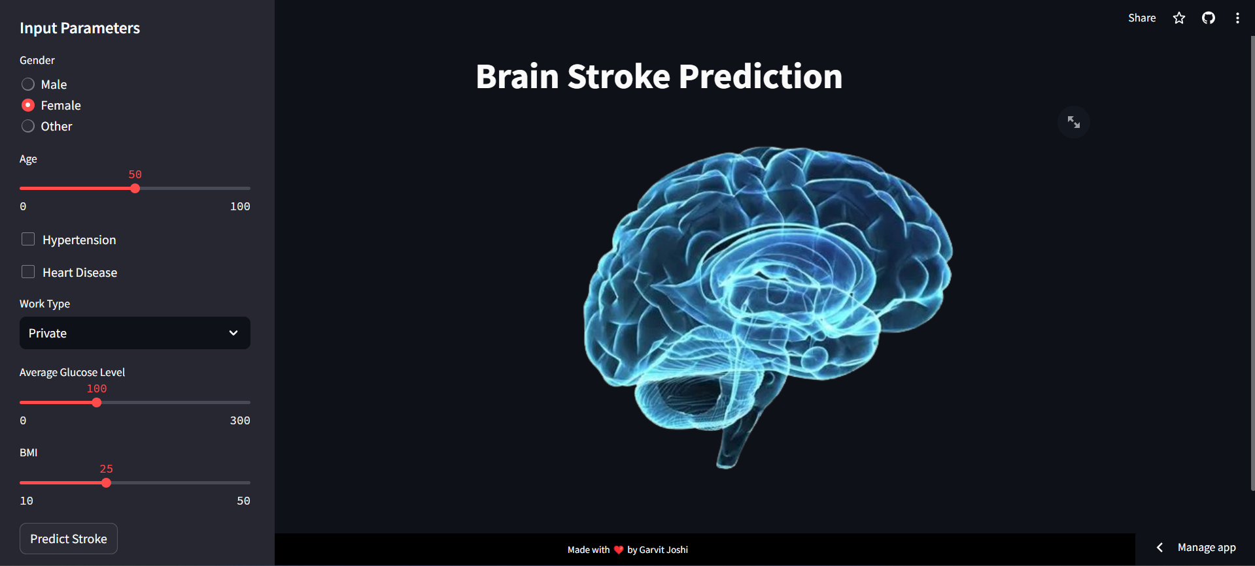
Deployment
Used Streamlit for deployment.
Streamlit is an open-source library which help user to deploy websites without using HTML, CSS in code.
Create Input widgets using slider and radio button for taking user inputs, making models giving input and predicting output by Logistic Regression, Random Forest, Gradient Boosting Algorithms.

Slide 8
Thank You

